Slide 1

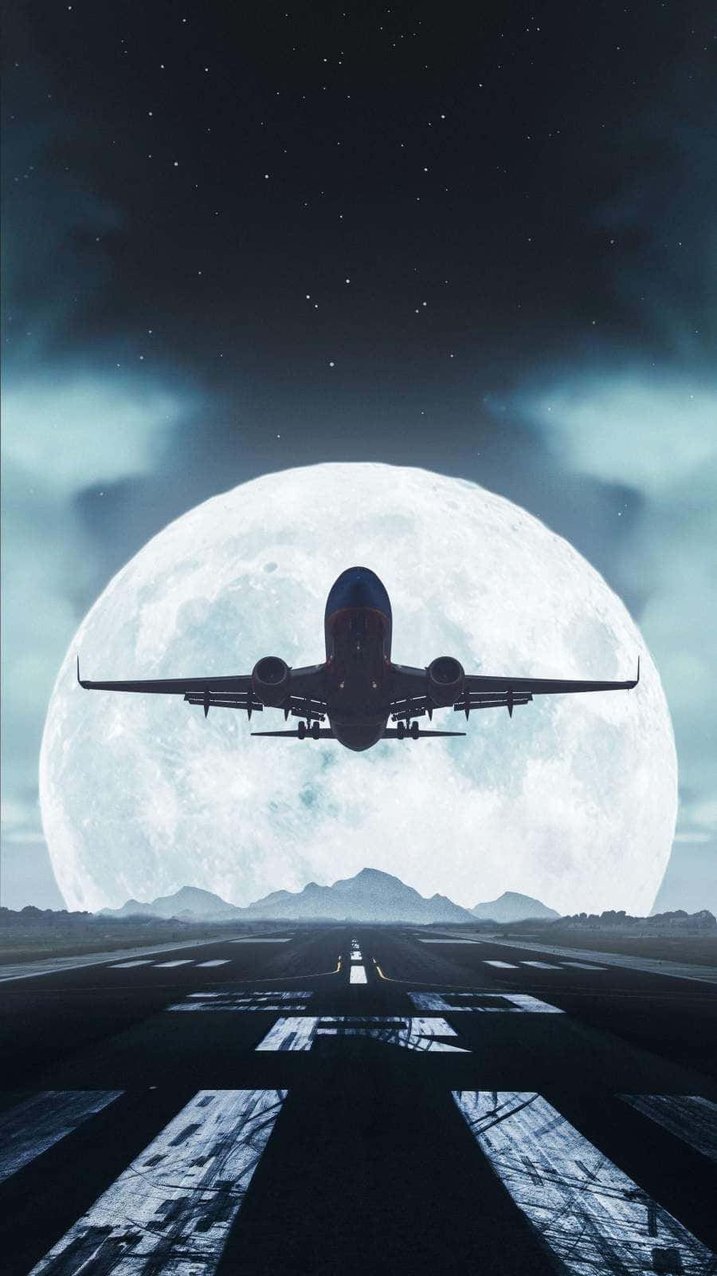

Slide 2
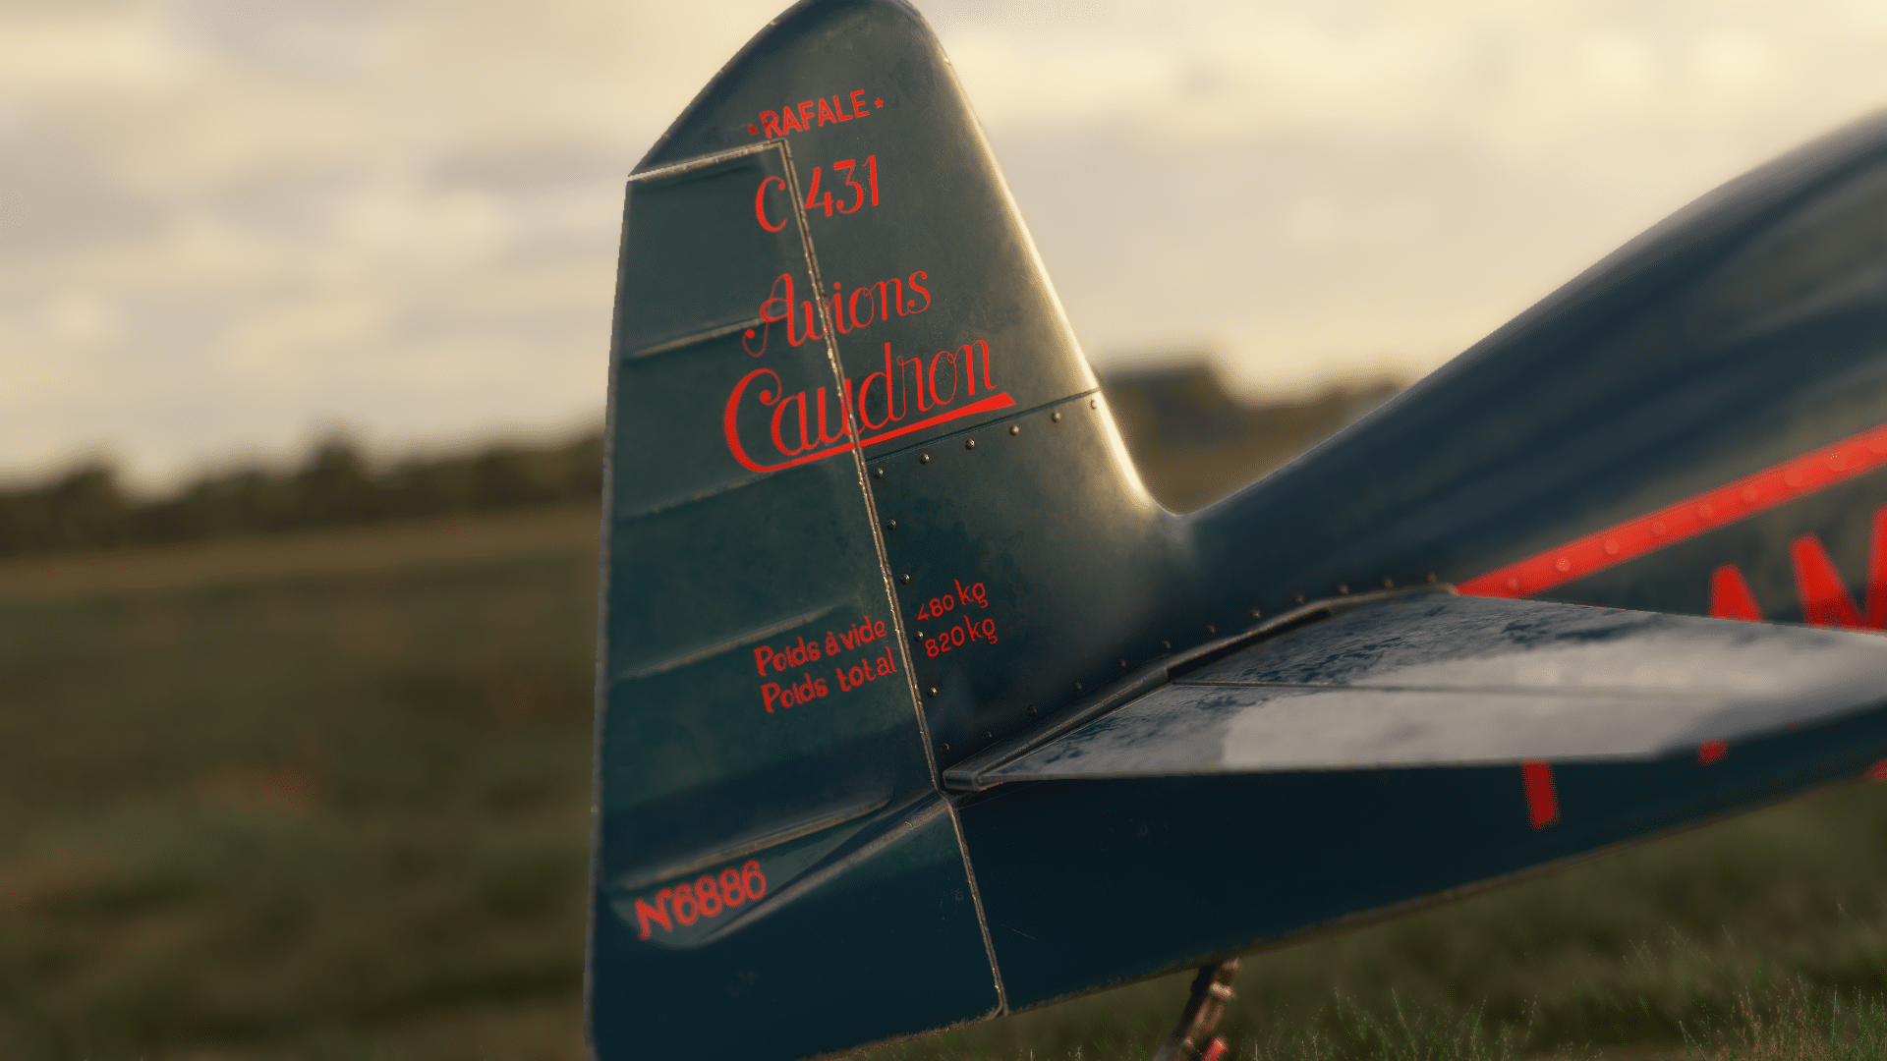
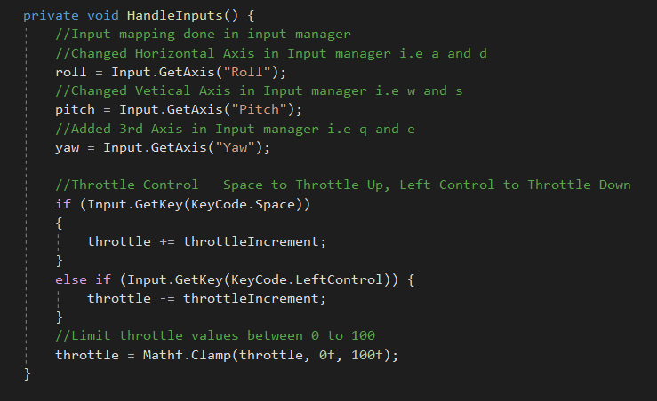
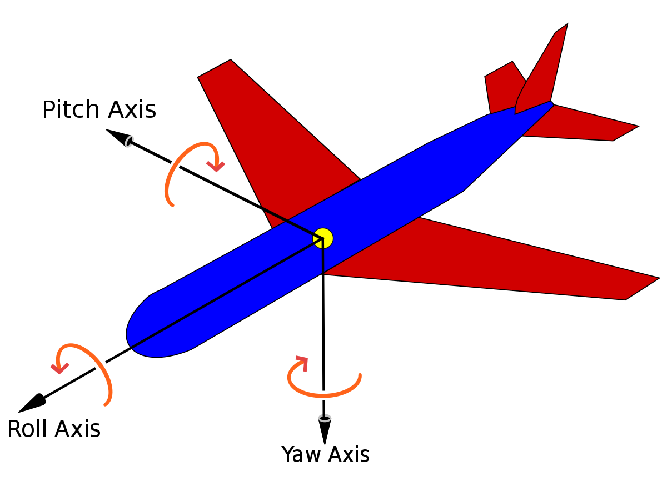
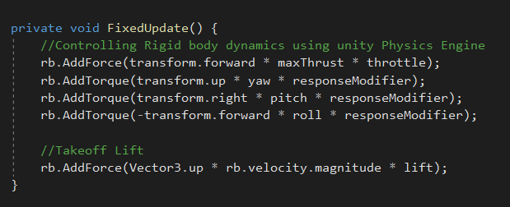

Slide 3

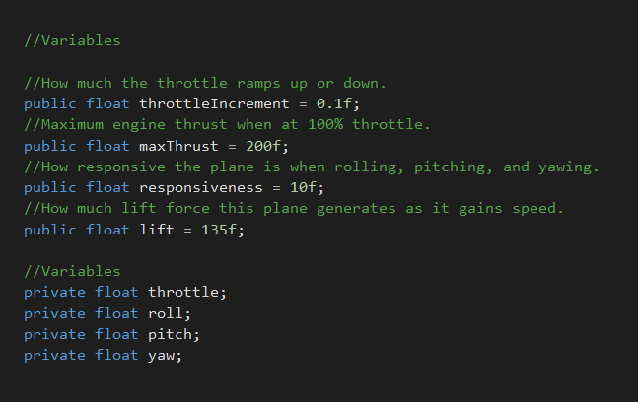
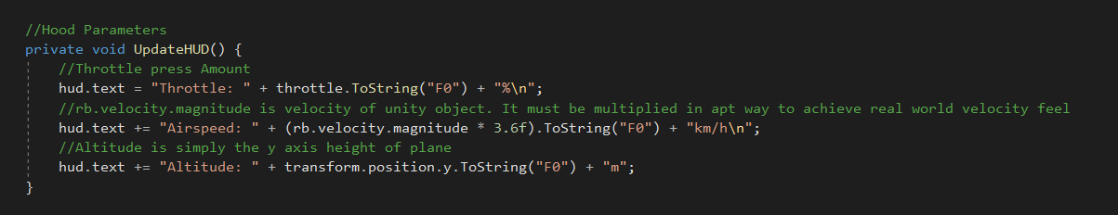

Slide 4
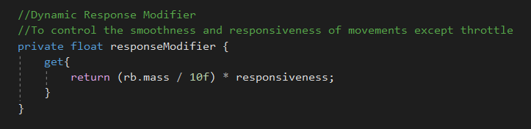
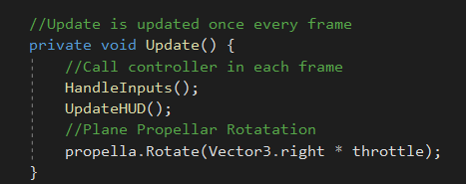

Slide 5
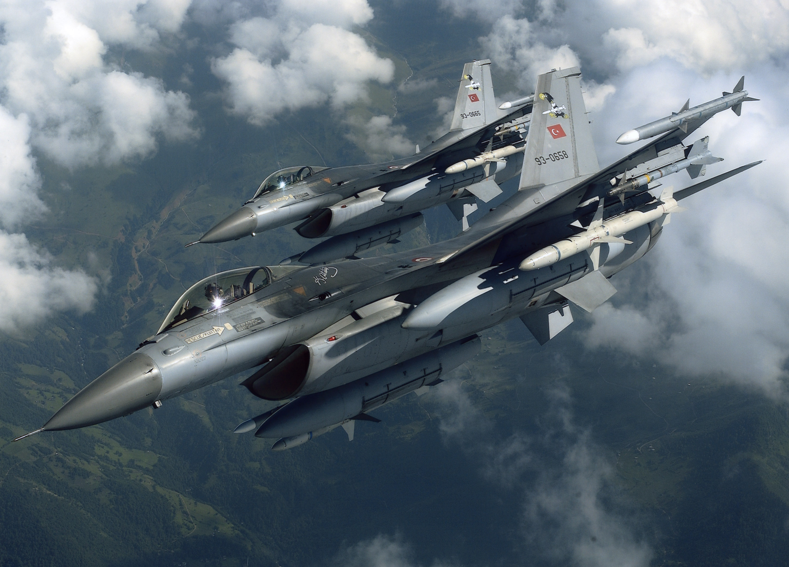
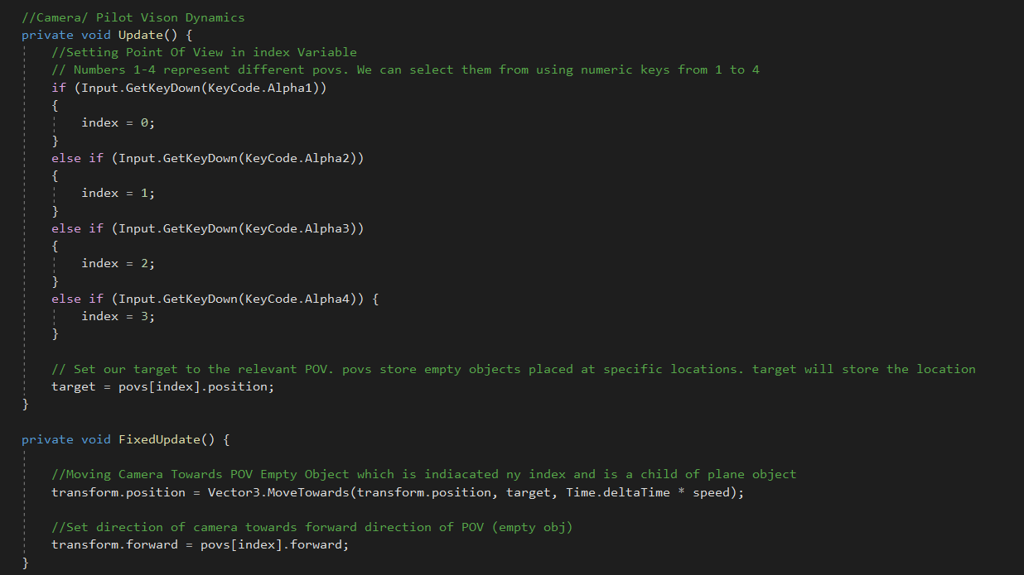

Slide 6
Plane Object
Parent
Child
Camera Object
Camera Controller Script
Plane Controller Script

Slide 7
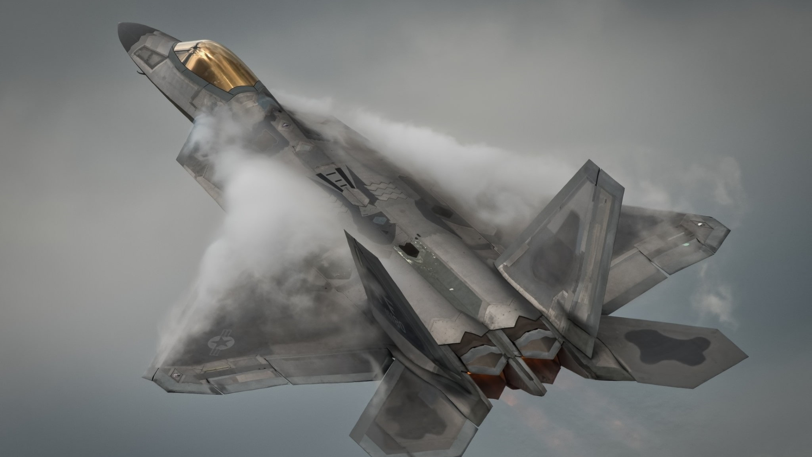
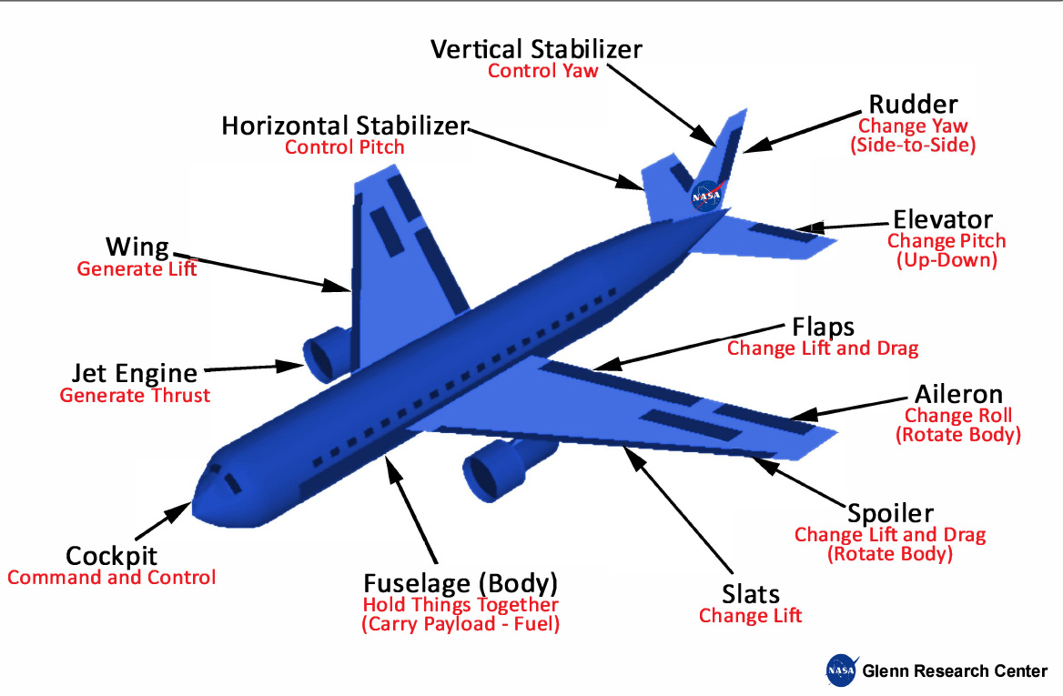
Next Step
Simulating Dynamics of Commercial Aircrafts

Slide 8
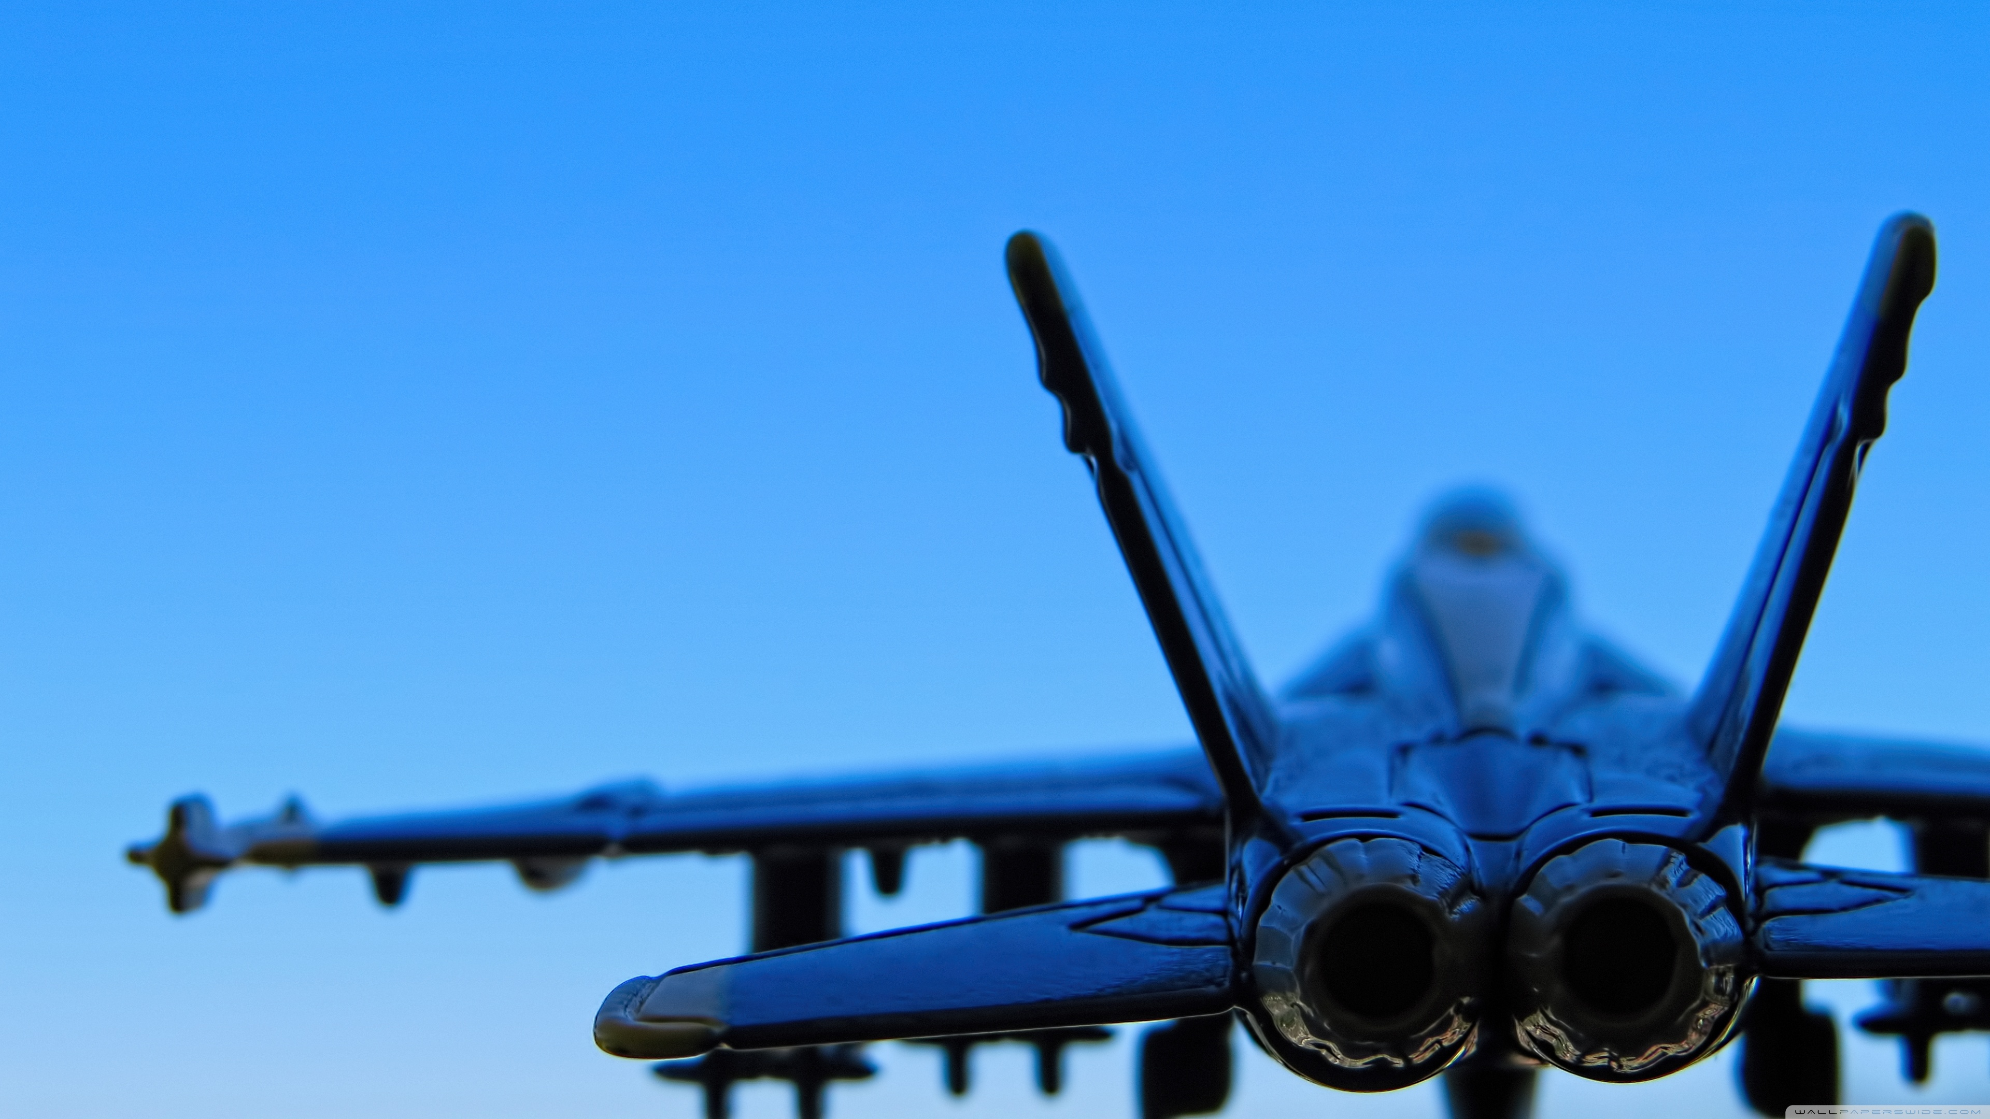
Resources
Unity Learn
https://learn.unity.com/course/beginner-scripting
Airplane Parts and Functions
https://www1.grc.nasa.gov/beginners-guide-to-aeronautics/airplane-parts-function/
Aircraft Dynamics
https://en.wikipedia.org/wiki/Aircraft_flight_dynamics
Google
https://www.google.com/
Pintrest
https://in.pinterest.com/

